Slide 1




Using Spherical Slepian Functions to Estimate Regional Ice Loss from Glaciers
Mateo De La Torre
Mentor: Christopher Harig
University of Arizona Department of Geosciences

Slide 2
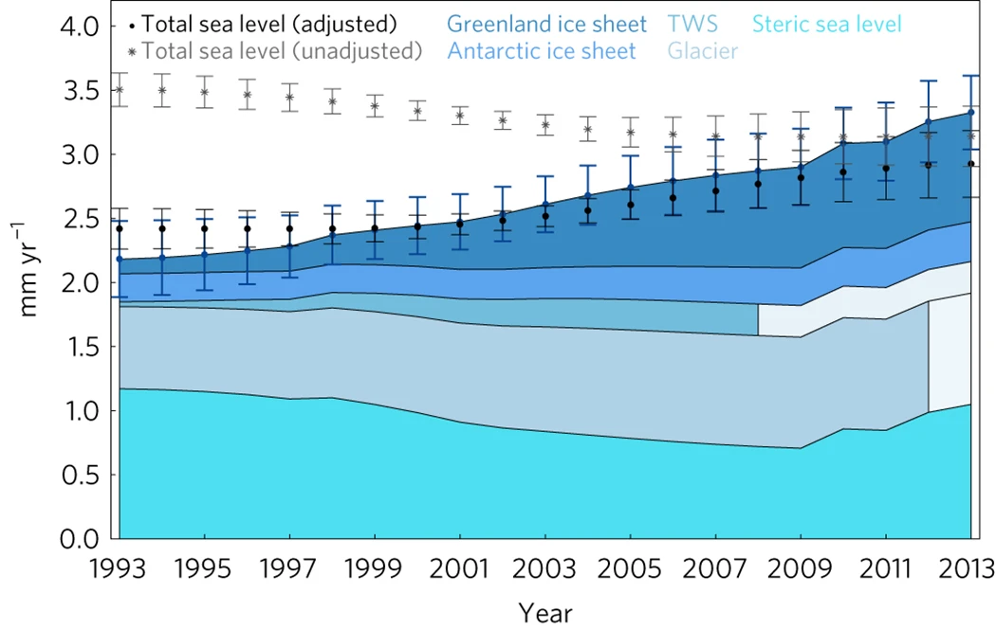
Introduction
Glaciers are losing significant mass as the globe warms
This threatens many communities in many ways from the equator to the poles
Quantifying such change become more important now than ever before
A recent study by an international research team, GlaMBIE, estimated sea level contributions as 18 mm
Instantaneous closure of the global mean sea-level budget. Chen et. al., 2017

Slide 3
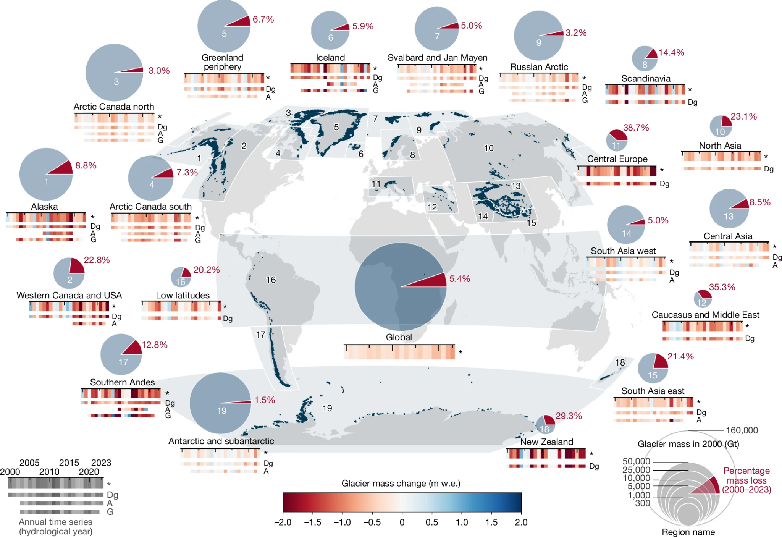
Objectives
Measuring ice mass balance and presenting data collected by the NASA GRACE/-FO missions
Apply these to the glacier regions defined by the Randolph Glacier Inventory (RGI)
Global glacier mass changes from 2000 to 2023. The GlaMBIE Team, 2025
Obtain estimates for ice mass balance across the world to submit to the Glacier Mass Balance Intercomparison Exercise (GlaMBIE)

Slide 4
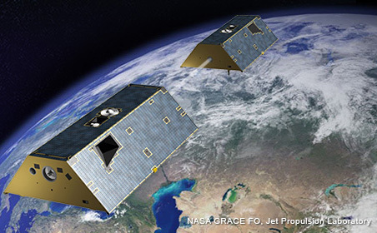
What is GRACE/-FO?
NASA satellite mission 2002-2017, 2018-present
Measures the time-variable gravity field of Earth every month
Credit: NASA/JPL
Returns data back in varying forms, most useful here are global gravity fields, distributed as spherical harmonics

Slide 5
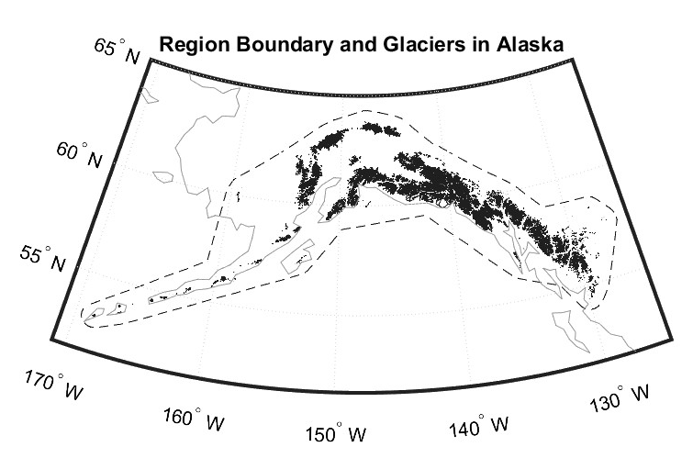
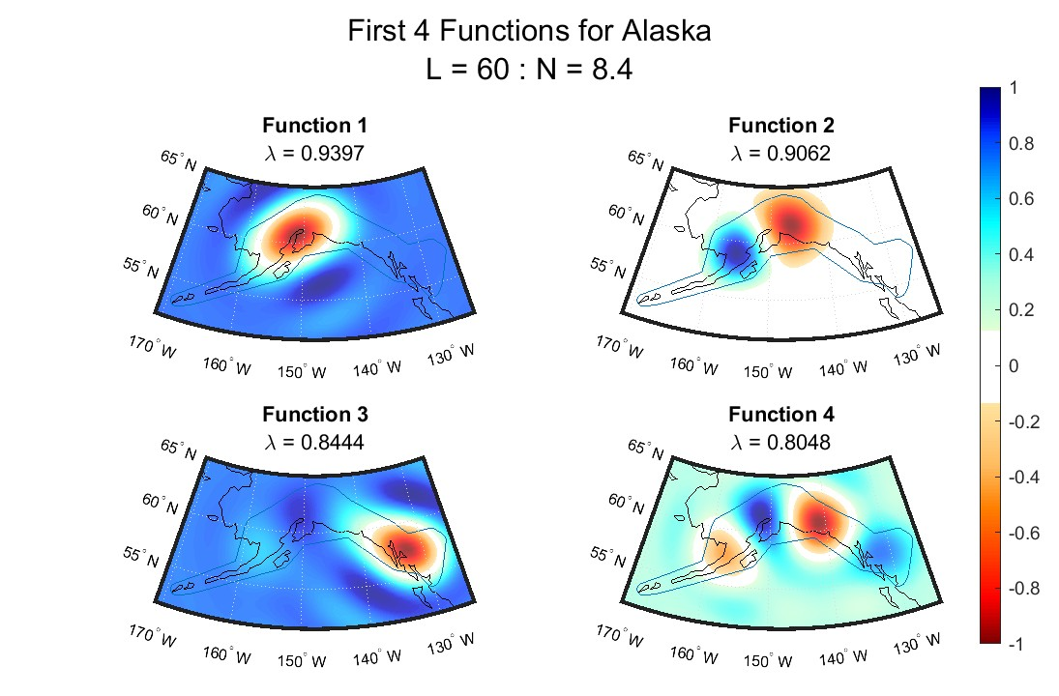
Methods
Global gravity fields are examined locally in each RGI region
Glaciers
Region
A new function basis is generated for that region to represent the gravity locally
Ice mass balance estimates are produced dependent on both space and time

Slide 6
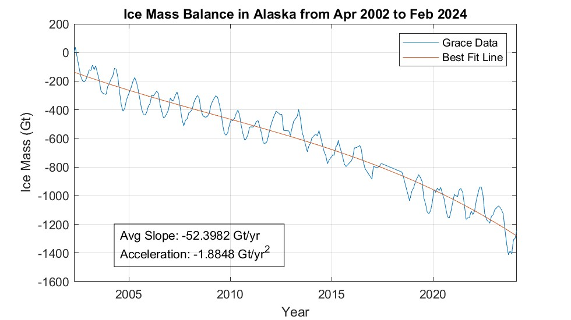
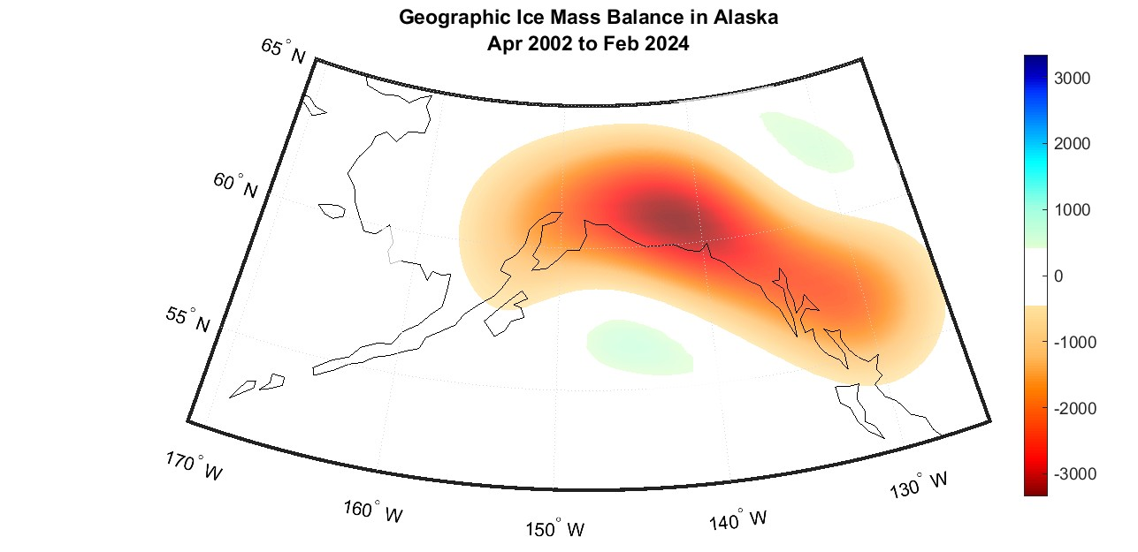
Results - Alaska
As an example, Alaska agrees fairly well with results from GlaMBIE (-60 Gt/yr) and others
This region is fairly sizeable and has a relatively high mass loss which lowers uncertainty which gives this estimate high confidence

Slide 7
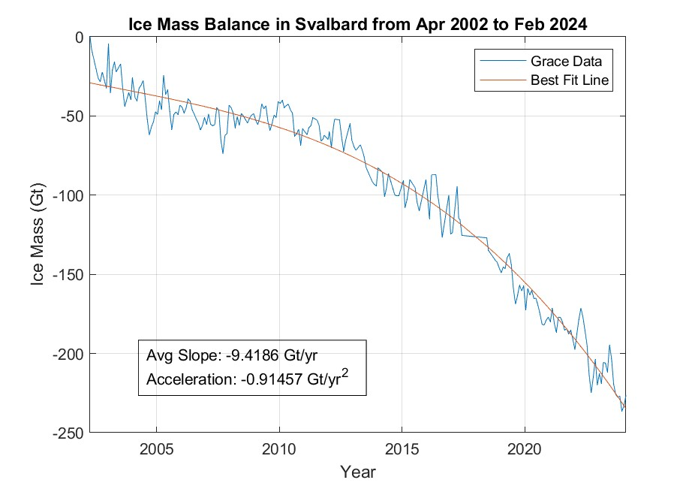
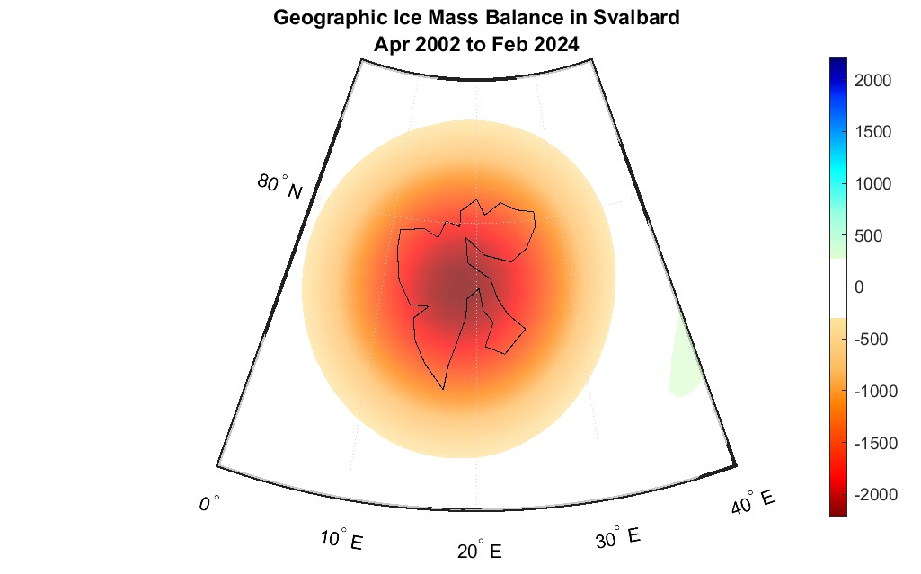
Results - Svalbard
Svalbard, while small in size, agrees well with other gravimetry groups (Wouters et. al. 2019) but not the best with GlaMBIE
Although similar to other gravimetric estimates, signal is more noisy because of the region size

Slide 8
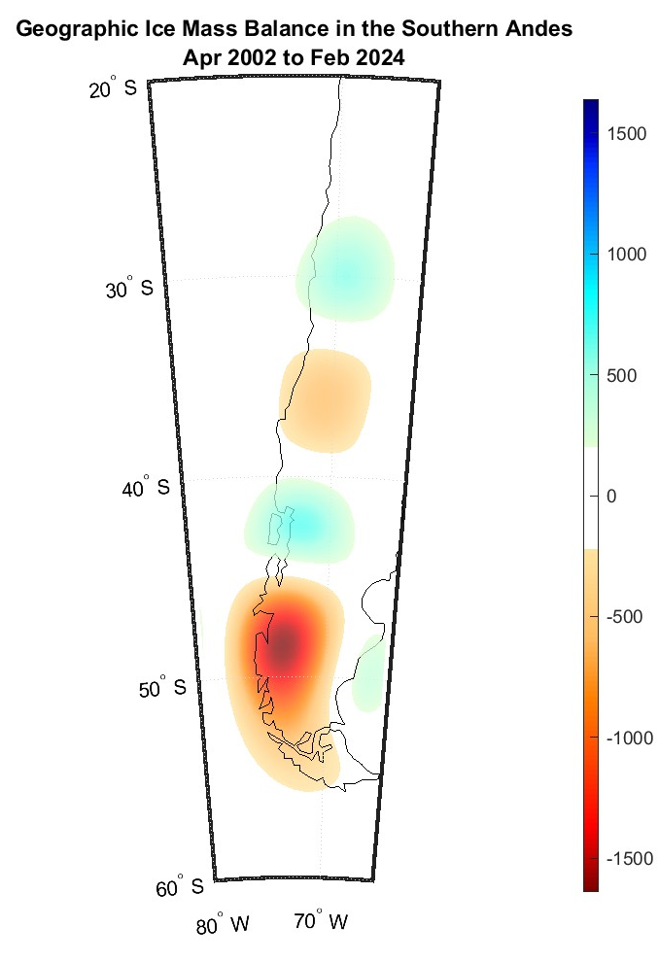
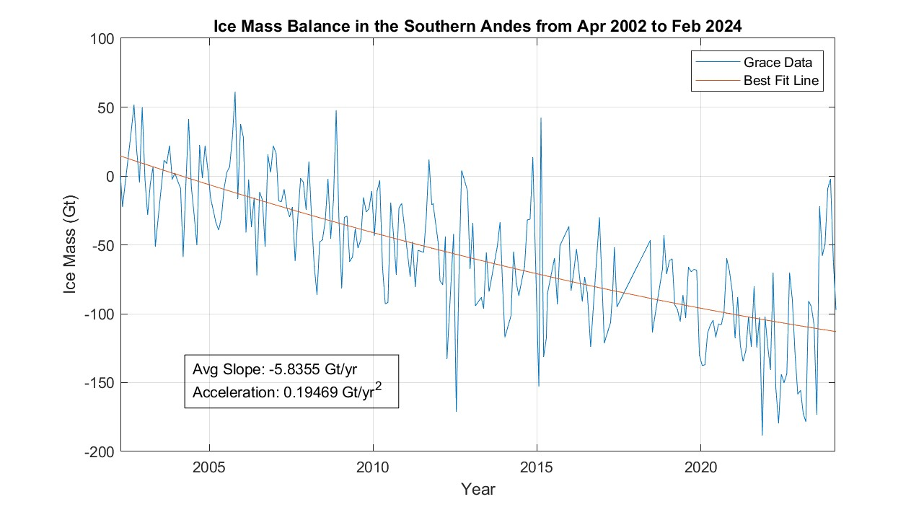
Results - Andes
The Southern Andes are a much more difficult region to close uncertainty in for a variety of factors

Slide 9
Conclusions
Only five of the 19 regions remain to be completed
Three of those comprise High Mountain Asia which present unique challenges
Results gathered here vary in uncertainty and confidence
Region | This Study | Wouters | GlaMBIE
Alaska | -52 Gt/yr | -53 Gt/yr | -60 Gt/yr
Svalbard | -9 Gt/yr | -7 Gt/yr | -14 Gt/yr
Andes | -5 Gt/yr | -30 Gt/yr | -27 Gt/yr
Global glacier mass changes from 2000 to 2023. The GlaMBIE Team, 2025

Slide 10
Acknowledgements
Christopher Harig
Eric Cicero
En-Chi Lee
Arizona Space Grant Consortium
UA Department of Geosciences

Slide 11
Thank You

Slide 12
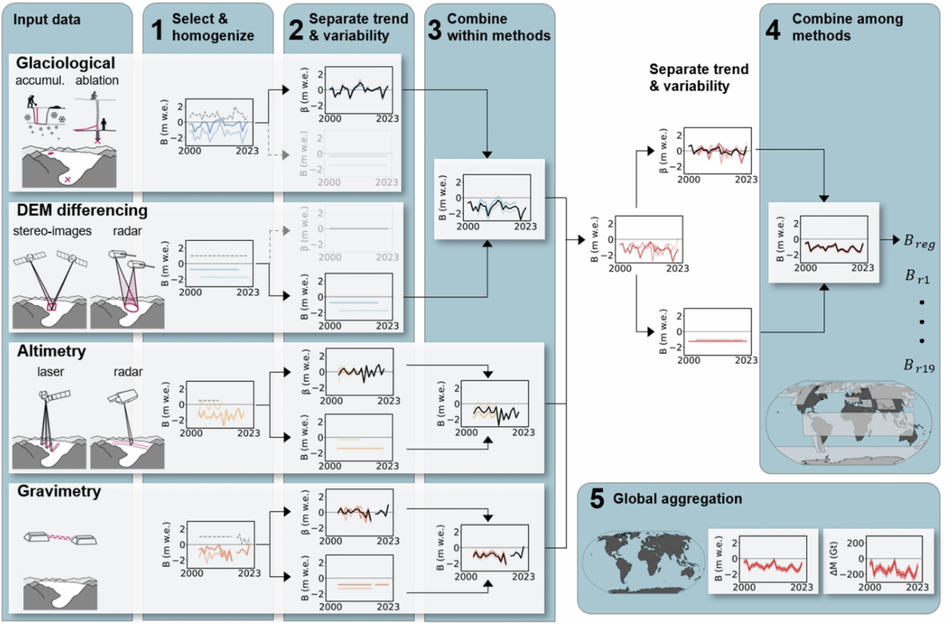
Principal approach and workflow of the intercomparison exercise. The GlaMBIE Team, 2025

Slide 13
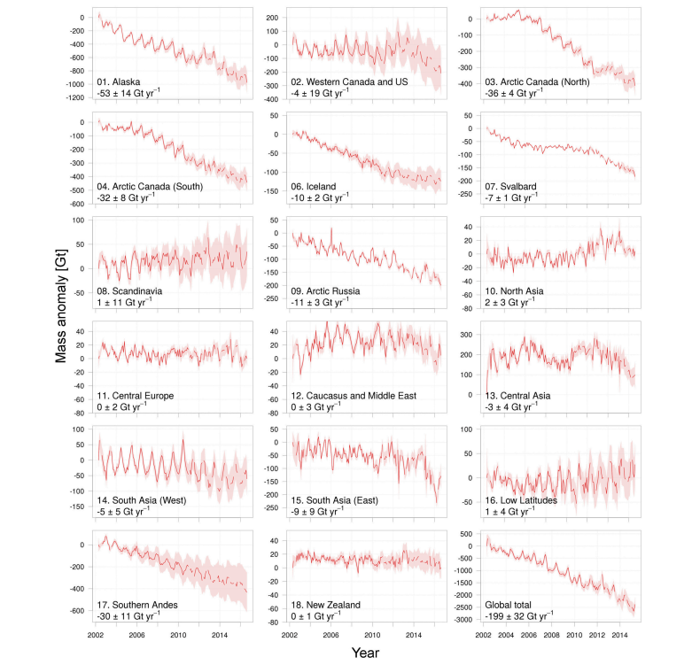
Time series of cumulative mass anomalies for all RGI regions. Wouters et. al., 2025

Slide 14
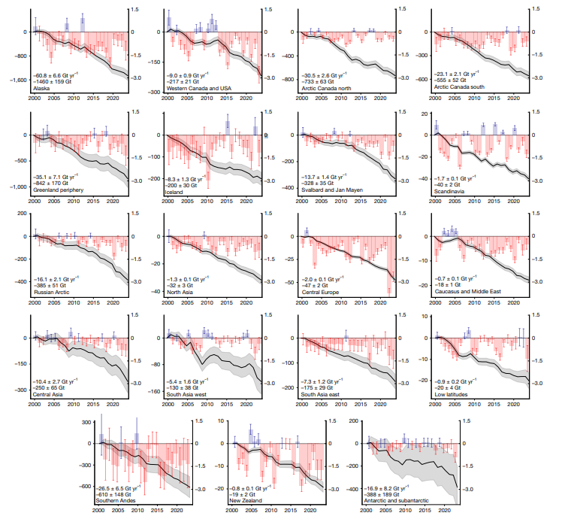
Annual and cumulative glacier mass change from 2000 to 2023. The GlaMBIE Team, 2025

